Slide 1



Face recognition in unconstrained environment using Deep Learning
Project ID: 22301
Anisha Mohanta
Roll no - 201843391
By
Swapnadeep Samal
Roll No:201810384
Under the guidance of
Prof. Pradeep Kumar Jena
Notes:
B-TECH PROJECT MID-SEM PRESENTATION 2011
BY KHUSHBU KHAN & ISAN SAHOO

Slide 2
OUTLINE
PROBLEM STATEMENT
OBJECTIVE
PROJECT SPECIFICATION REQUIREMENTS
DEEP LEARNING AND CNN
DATA COLLECTION AND ANALYSIS
DEVELOPING CNN MODEL
FUTUTRE WORKS
CONCLUSION
REFERENCES
Notes:
B-TECH PROJECT MID-SEM PRESENTATION 2011
BY KHUSHBU KHAN & ISAN SAHOO
2

Slide 3
PROBLEM STATEMENT
Developing a highly efficient face recognition framework to learn a robust face detection in an unconstrained environment using aggressive data augmentation and CNN.
To learn face representation from large-scale data with massive noisy and occluded face.
Notes:
B-TECH PROJECT MID-SEM PRESENTATION 2011
BY KHUSHBU KHAN & ISAN SAHOO
3

Slide 4
OBJECTIVE
To design an effective face recognition system that has an ability to recognize the faces in real-time.
This effective system will also be able to identify the faces even when there is a massive noise present within the image.
Notes:
B-TECH PROJECT MID-SEM PRESENTATION 2011
BY KHUSHBU KHAN & ISAN SAHOO
4

Slide 5
PROJECT SPECIFICATIONS AND REQUIREMENTS
The requirements for developing the results of the project are listed below:-
Python
Jupyter Notebook
Python libraries –
Numpy
Pandas
Tensorflow
Keras
Scikit – Learn
Notes:
B-TECH PROJECT MID-SEM PRESENTATION 2011
BY KHUSHBU KHAN & ISAN SAHOO
5

Slide 6
DEEP LEARNING
Deep learning is a machine learning technique that teaches computers to do what comes naturally to humans: learn by example
In this, a computer model learns to perform classification tasks directly from images, text or sound.
Why Deep Learning?
Helps to meet the user expectations, and it is crucial for safety critical applications
Because of accuracy
Notes:
B-TECH PROJECT MID-SEM PRESENTATION 2011
BY KHUSHBU KHAN & ISAN SAHOO
6

Slide 7
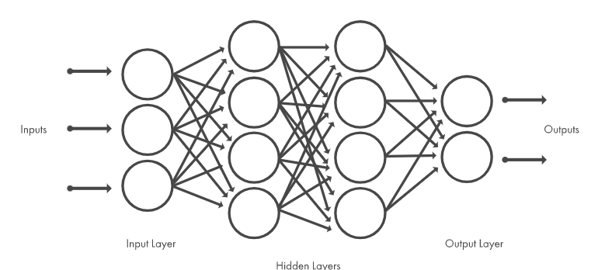
DEEP LEARNING
How does it works ?
Deep learning methods use neural network architectures
There are a number of hidden layers in the neural network
Trained using a large sets of data and neural network architectures that learn features directly
Notes:
B-TECH PROJECT MID-SEM PRESENTATION 2011
BY KHUSHBU KHAN & ISAN SAHOO
7

Slide 8
CONVOLUTIONAL NEURAL NETWORK (CNN)
It is a special type of Neural Networks, which has shown exemplary performance on several competitions related to Computer Vision and Image Processing.
The powerful learning ability of deep CNN is primarily due to the use of multiple feature extraction stages that can automatically learn representations from the data.
The availability of a large amount of data and improvement in the hardware technology has accelerated the research in CNNs.
Notes:
B-TECH PROJECT MID-SEM PRESENTATION 2011
BY KHUSHBU KHAN & ISAN SAHOO
8

Slide 9
CONVOLUTION NEURAL NETWORK (CNN)
The CNNs have several different filters/kernels consisting of trainable parameters which can convolve on a given image spatially to detect features like edges and shapes.
There are different layers that are used in order to build an efficient CNN model.
Convolutional Layer
Batch Normalization Layer
Max Pooling Layer
Fully Connected Layer

Slide 10
DATASET COLLECTION AND ANALYSIS
The dataset collection of human faces for face recognition are done
The process flow of the data collection as follows:
Identify the location of face in the video frame.
Extract the face image and convert into gray scale image.
Attach the label w.r.t to the class of the image and write into a csv file.
Data Augmentation is a strategy that enables practitioners to significantly increase the diversity of data available for training models, without actually collecting huge data.
In the current work, synthetic images are being generated randomly, by applying the following operations:
Zoom, Shear, Height Shift, Rotation, Width Shift, etc.

Slide 11
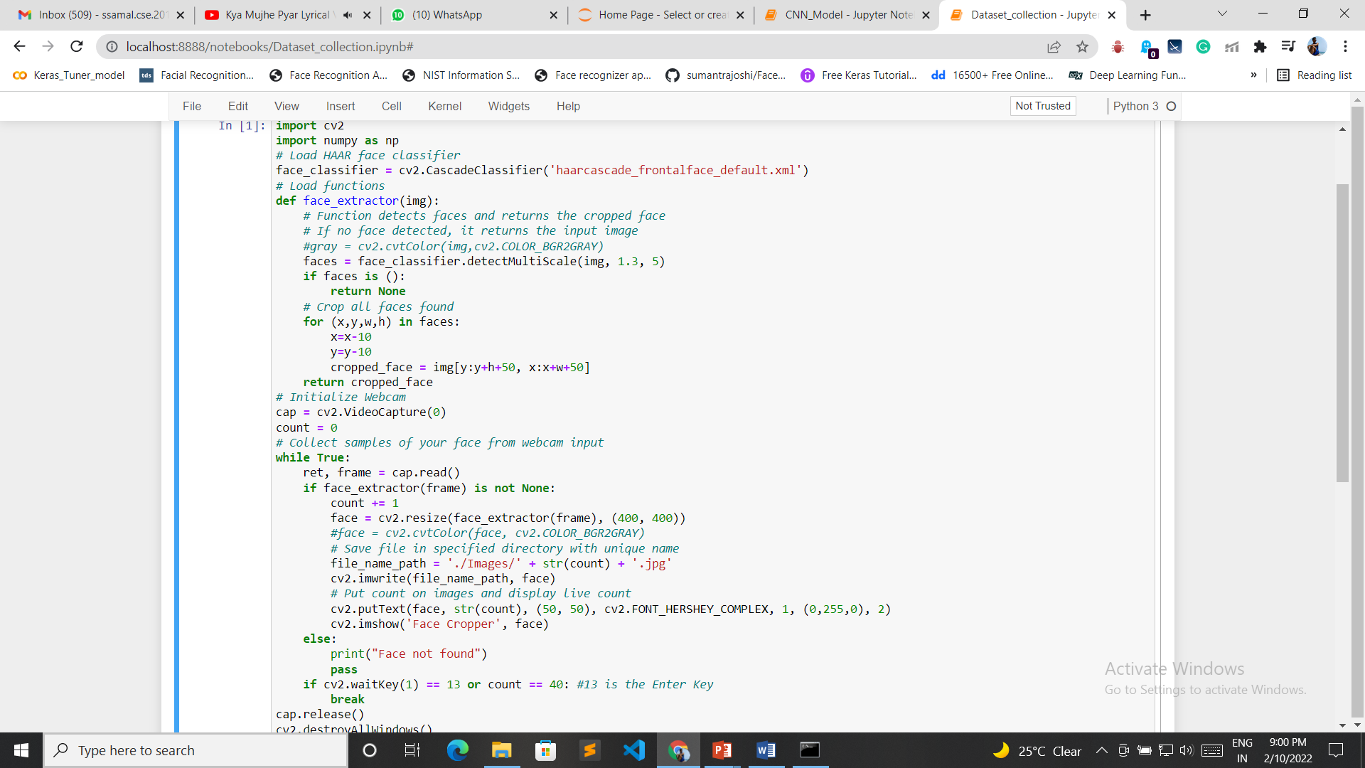
DATASET COLLECTION AND ANALYSIS

Slide 12
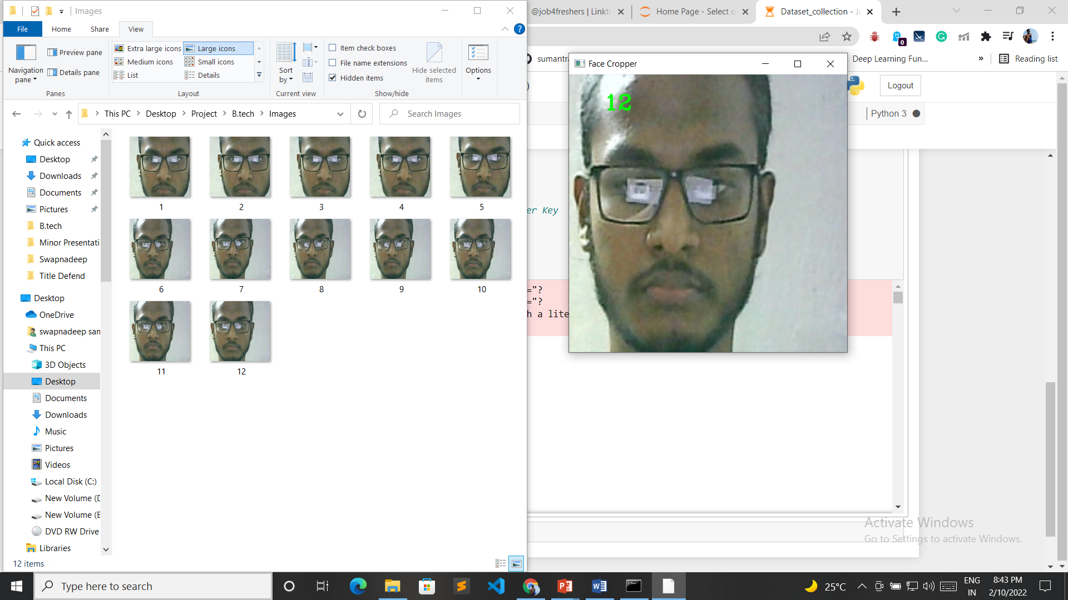
DATASET COLLECTION AND ANALYSIS

Slide 13
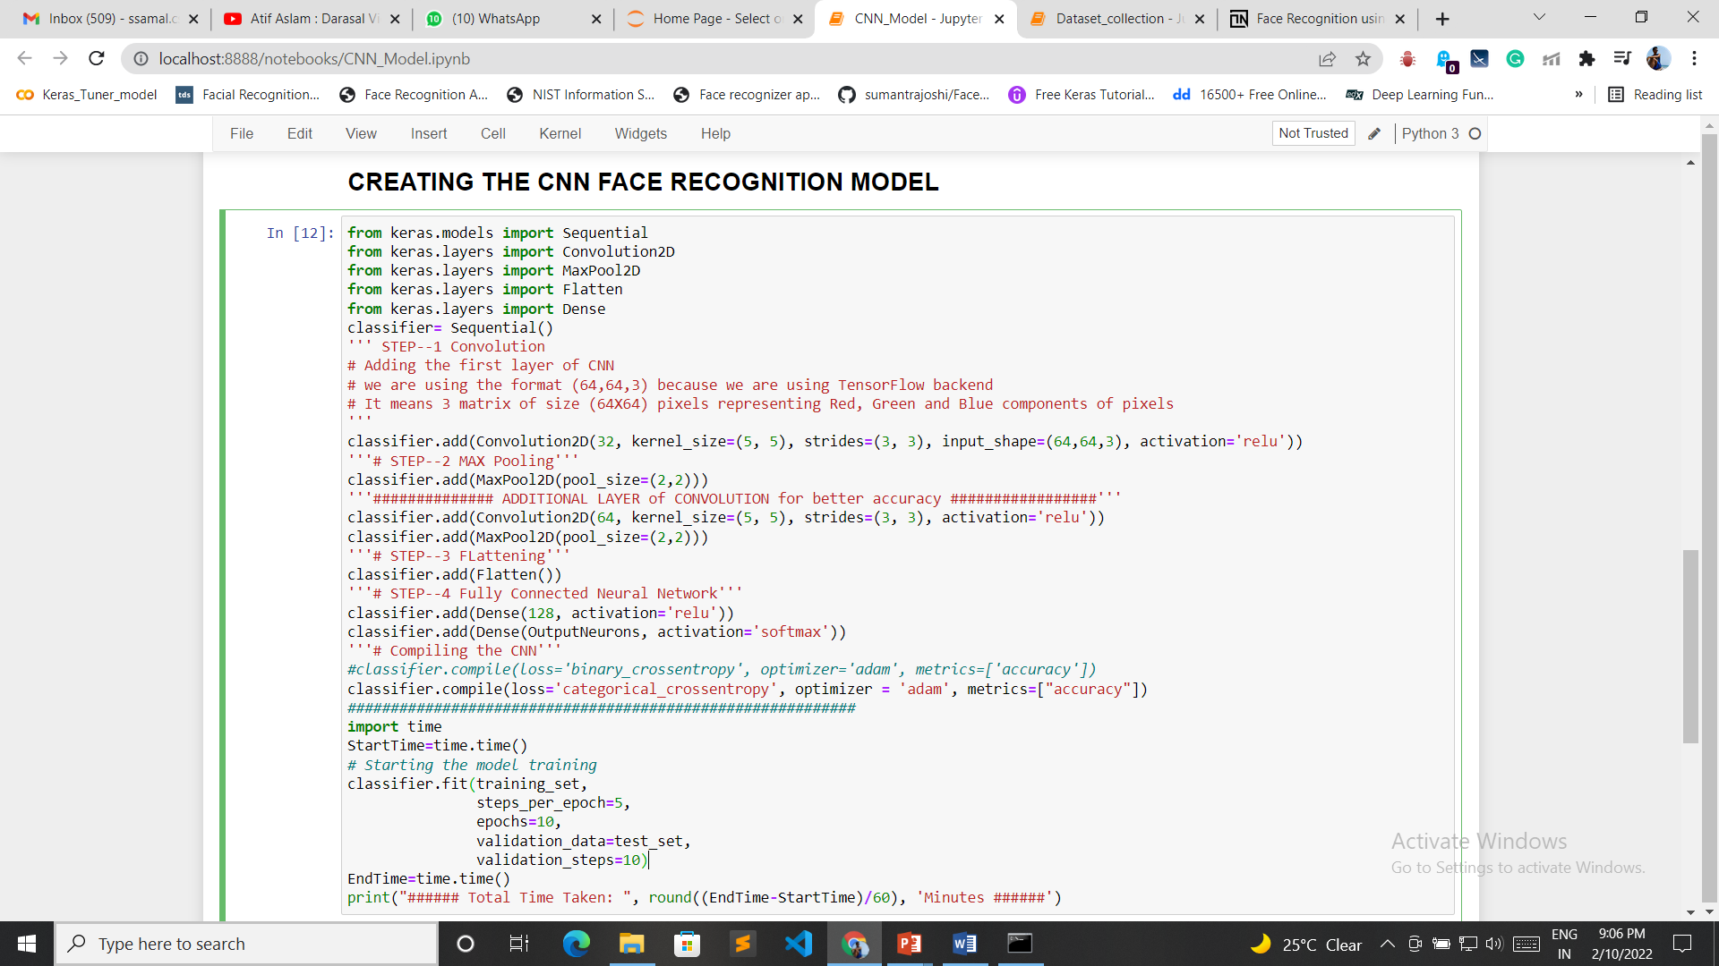
DEVELOPING THE MODEL CODE

Slide 14
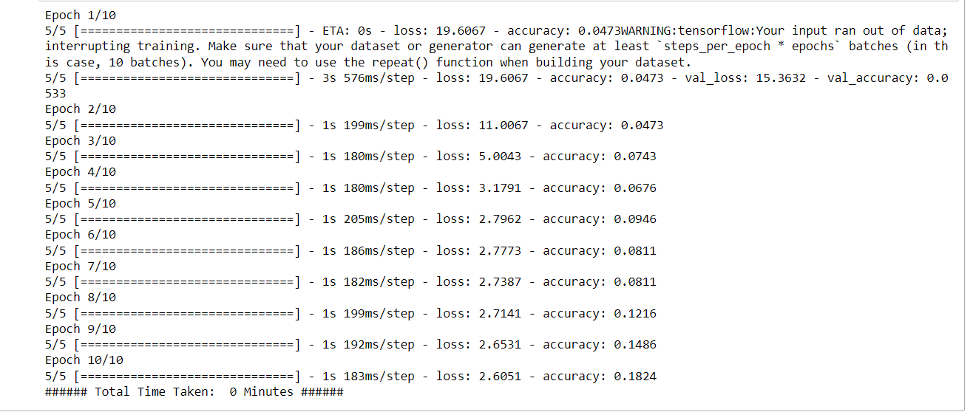
DEVELOPING THE MODEL CODE

Slide 15
FUTURE WORKS
Testing of the CNN model, then checking whether the model is able to recognize the face or not.
Testing the model in real-time environment whether the model is able to recognize the face or not.

Slide 16
CONCLUSION
This overall procedure of face recognition and identification system is designed using deep learning approach.
The CNN approach for face recognition can affect the accuracy of the system.
This project aims at real time recognition process where aggressive data augmentation can lead to recognition even in low light intensity.

Slide 17
REFERENCCES
S. Albawi, T. A. Mohammed, and S. Al-Zawi, “Understanding of a convolutional neural network,” in 2017 International Conference on Engineering and Technology (ICET). IEEE, 2017, pp. 1–6.
G. Hu, Y. Yang, D. Yi, J. Kittler, W. Christmas, S. Z. Li, and T. Hospedales, “When face recognition meets with deep learning: an evaluation of convolutional neural networks for face recognition,” in Proceedings of the IEEE international conference on computer vision workshops, 2015, pp. 142–150.
J. Redmon, S. Divvala, R. Girshick, and A. Farhadi, “You only look once: Unified, real-time object detection,” in Proceedings of the IEEE conference on computer vision and pattern recognition, 2016, pp. 779–788.
A. Khan, A. Sohail, U. Zahoora, and A. S. Qureshi, “A survey of the recent architectures of deep convolutional neural networks,” arXiv preprint arXiv:1901.06032, 2019.

Slide 18
Thank You

